Slide 1
Complexometric Titrations

Slide 2
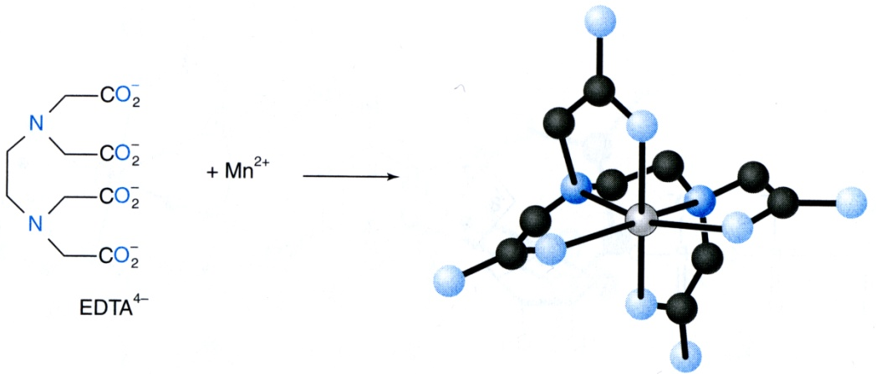
EDTA Titrations
Introduction
1.) Metal Chelate Complexes
Any reagent which reacts with an analyte in a known ratio and with a large equilibrium constant can potentially be used in a titration.
Complexation Titrations are based on the reaction of a metal ion with a chemical agent to form a metal-ligand complex.
Metal
Ligand
Metal-Ligand Complex
Note: multiple atoms from EDTA are binding Mn²⁺
Metal – Lewis Acid or Electron-pair acceptor
Ligand – Lewis Base or Electron-pair donor

Slide 3
EDTA Titrations
EDTA
1.) EDTA (Ethylenediaminetetraacetic acid)
One of the most common chelating agents used for complexometric titrations in analytical chemistry.
EDTA has 6 (nitrogens & oxygens )in its structure giving it 6 free electron pairs that it can donate to metal ions.
High K_{f} values
6 acid-base sites in its structure

Slide 4
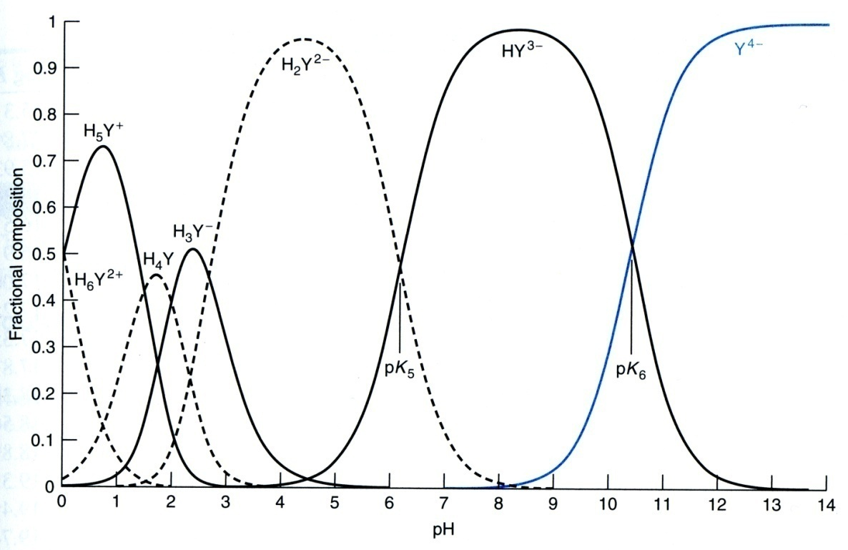
EDTA Titrations
EDTA
2.) Acid-Base Forms
EDTA exists in up to 7 different acid-base forms depending on the solution pH.
The most basic form (Y⁴⁻) is the one which primarily reacts with metal ions.
EDTA-Mn Complex

Slide 5
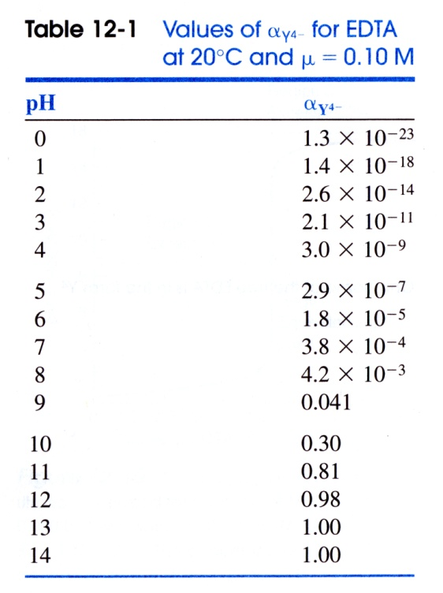
EDTA Titrations
EDTA
2.) Acid-Base Forms
Fraction (α) of the most basic form of EDTA (Y⁴⁻) is defined by the H⁺ concentration and acid-base equilibrium constants
Fraction (α) of EDTA in the form Y⁴⁻ :
where [EDTA] is the total concentration of all free EDTA species in solution
α_{Y4-} is depended on the pH of the solution

Slide 6
EDTA Titrations
EDTA
3.) EDTA Complexes
The basic form of EDTA (Y⁴⁻) reacts with most metal ions to form
a 1:1 complex.
Other forms of EDTA will also chelate metal ions
Recall: the concentration of Y⁴⁻ and the total concentration of EDTA is solution [EDTA] are related as follows:
Note: This reaction only involves Y⁴⁻, but not the other forms of EDTA
where α_{Y4-}is dependent on pH

Slide 7
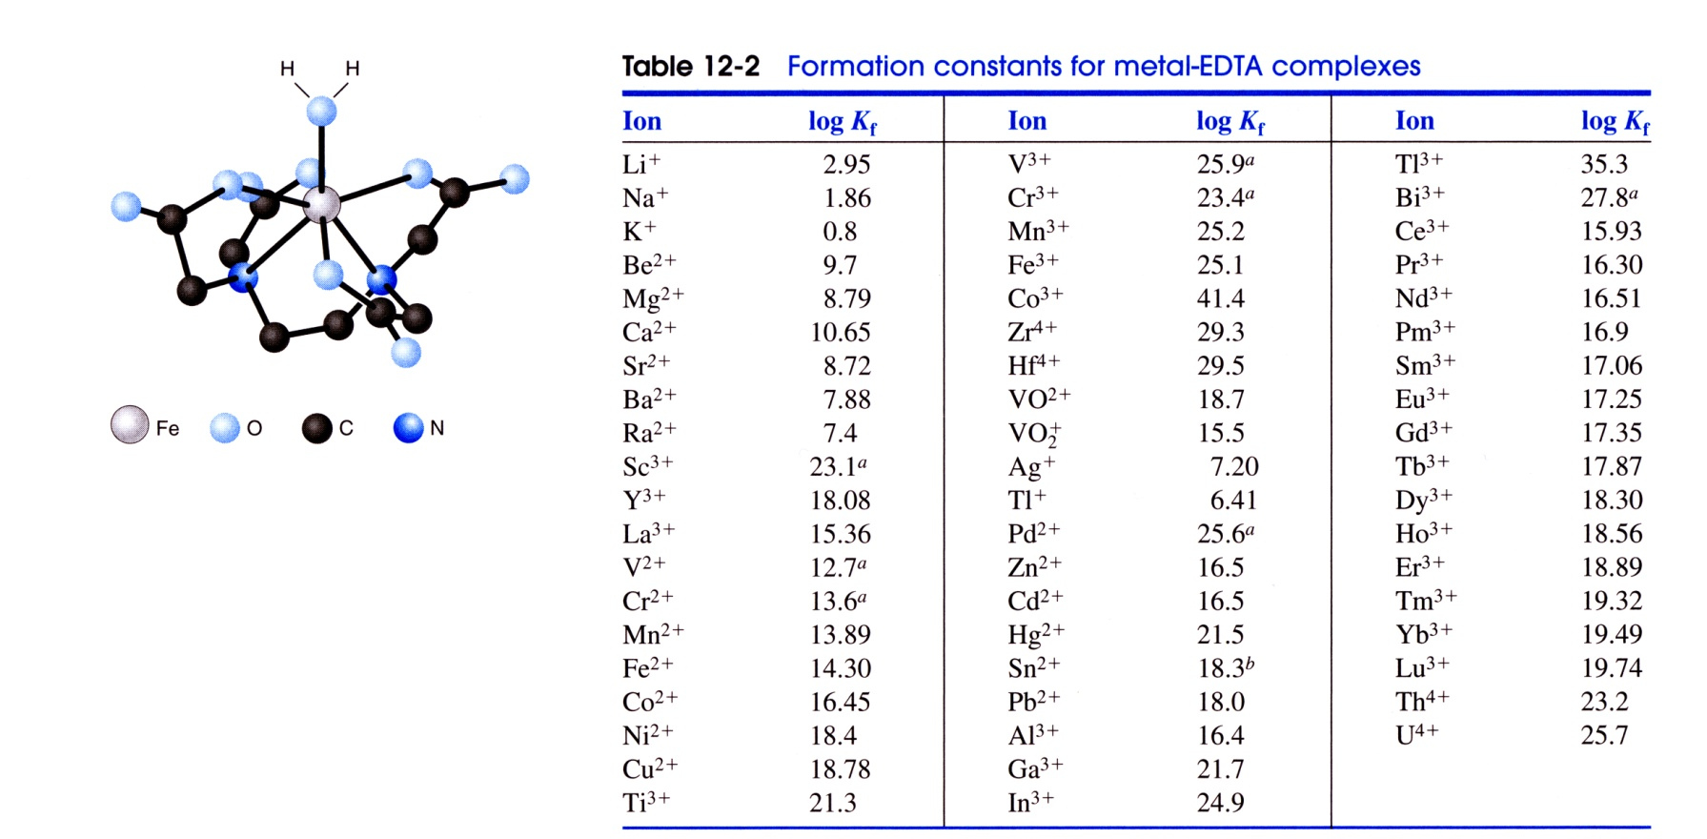
EDTA Titrations
EDTA
3.) EDTA Complexes
The basic form of EDTA (Y⁴⁻) reacts with most metal ions to form
1:1 complex.

Slide 8
EDTA Titrations
EDTA
3.) EDTA Complexes
Substitute [Y⁴⁻] into K_{f} equation
If pH is fixed by a buffer, then α_{Y4-} is a constant that can be combined with K_{f}
where [EDTA] is the total concentration of EDTA added to the solution not bound to metal ions
Conditional formation constant:ثابت التكوين الشرطي
(at a given pH)

Slide 9
EDTA Titrations
EDTA
3.) EDTA Complexes
Assumes the uncomplexed EDTA were all in one form
at any pH, we can find α_{Y4-} and evaluate K_{f}’

Slide 10
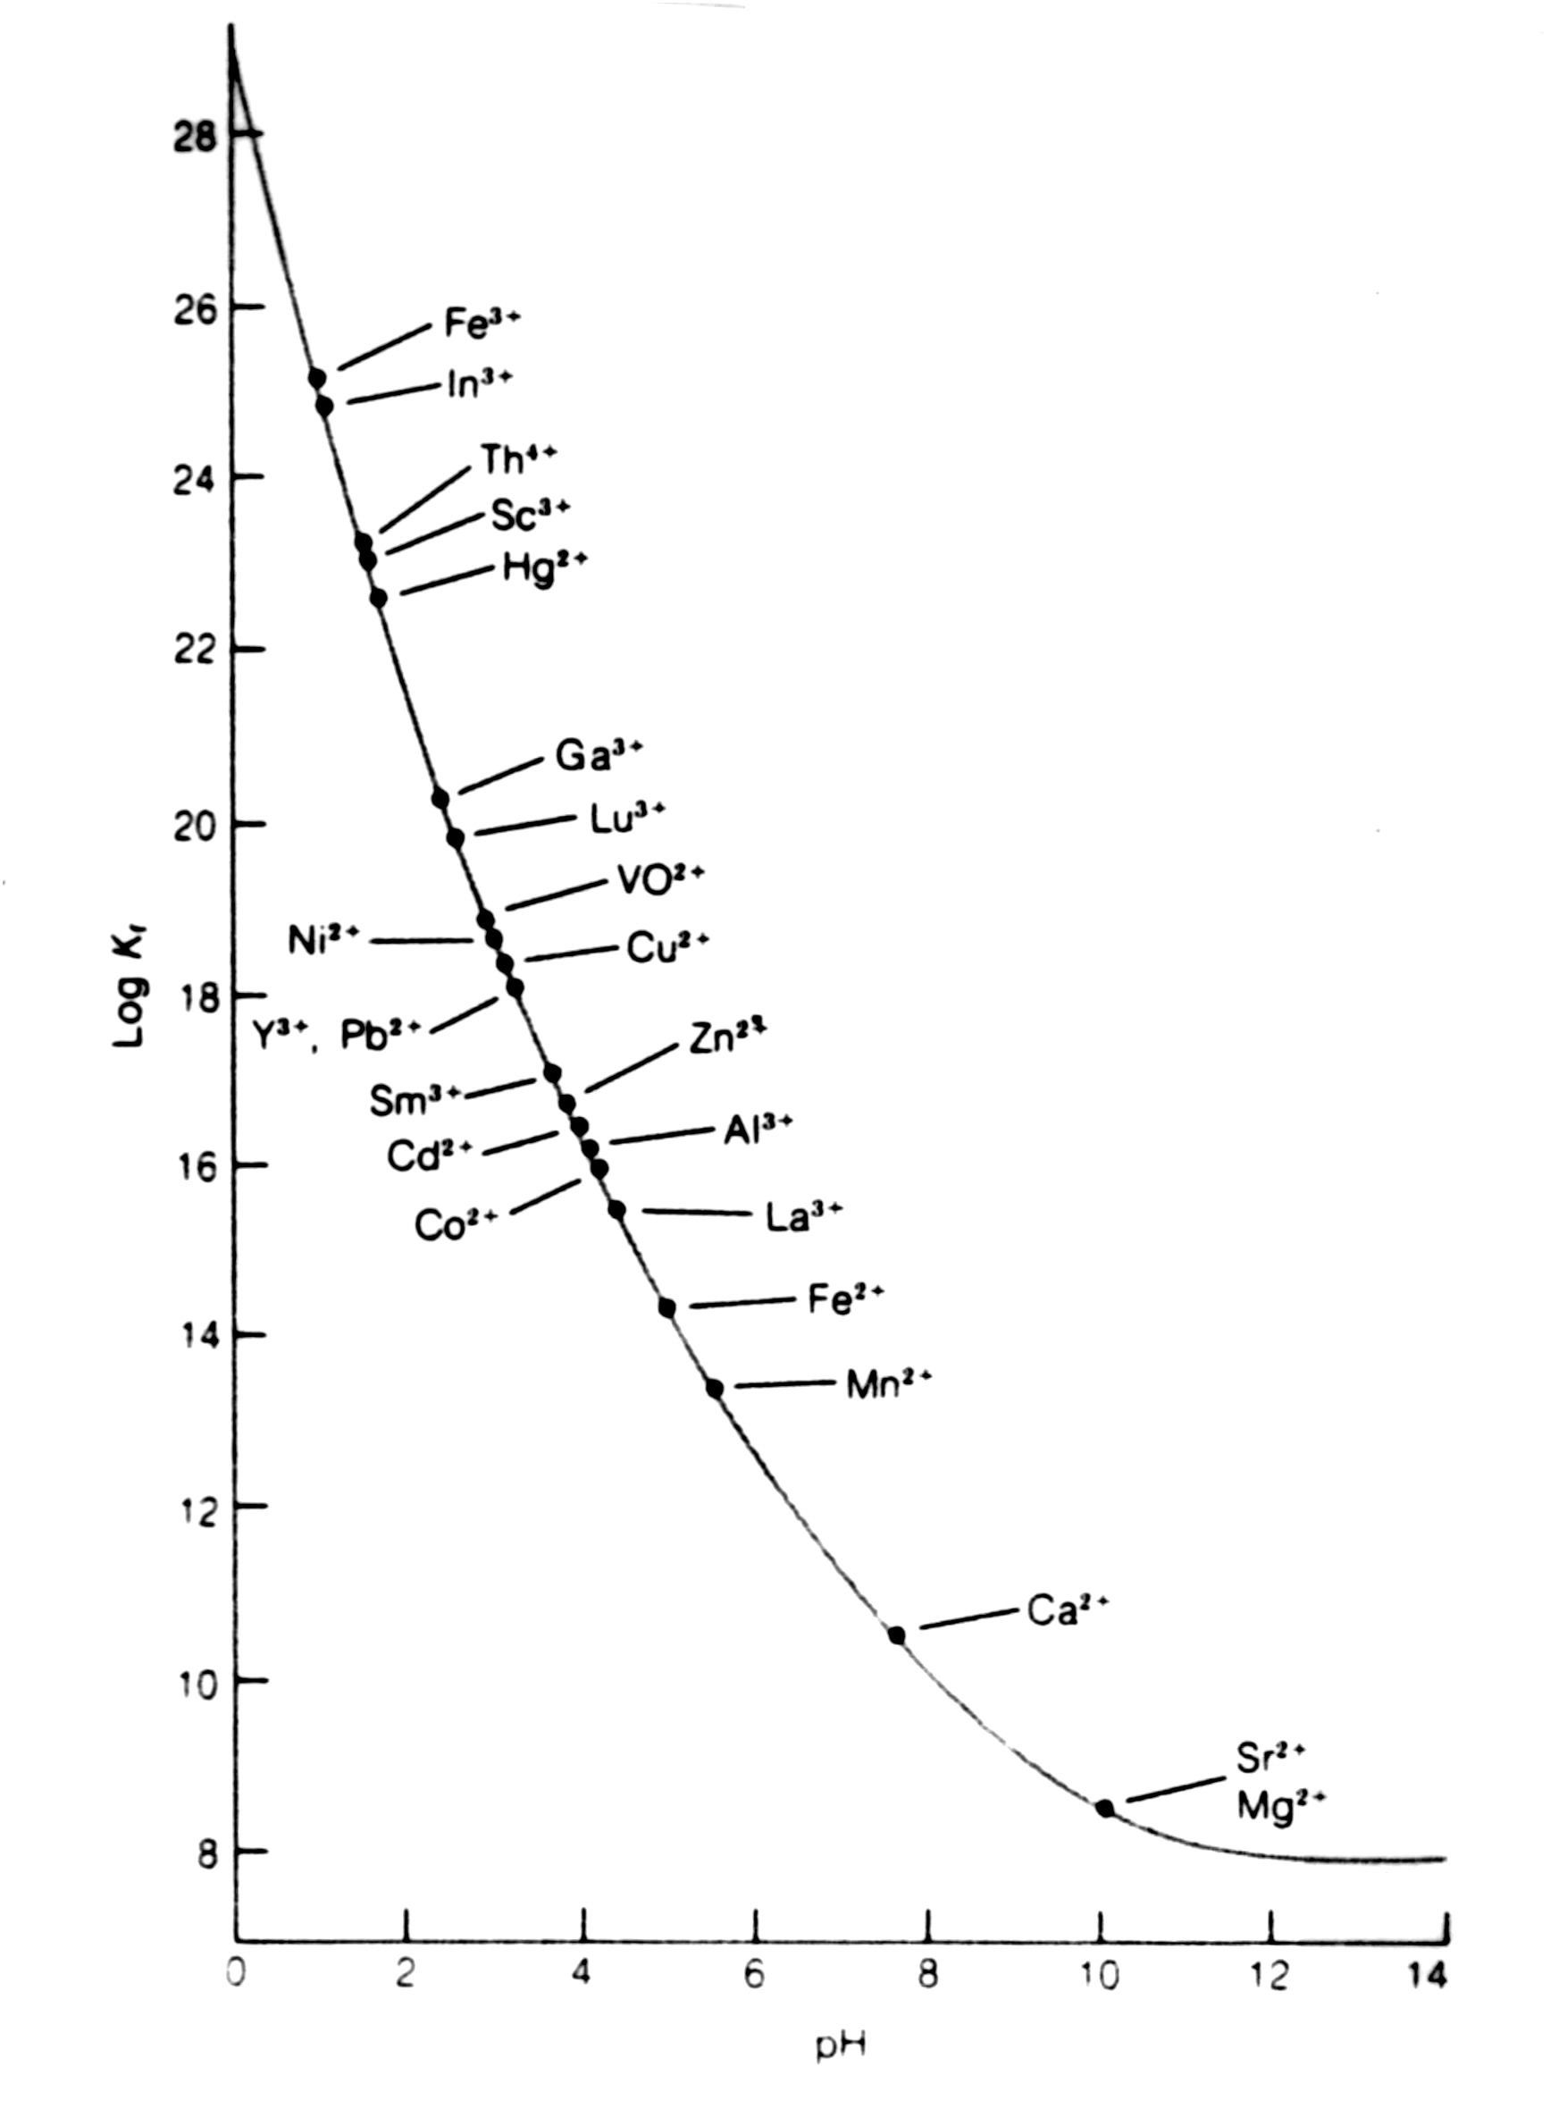
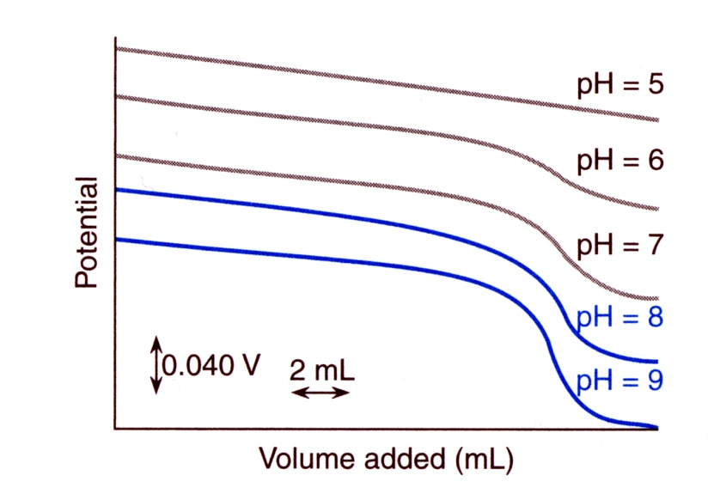
EDTA Titrations
Minimum pH for Effective Titration of Metal Ions
EDTA
5.) pH Limitation
By adjusting the pH of an EDTA titration:
one type of metal ion (e.g. Fe³⁺) can be titrated without interference from others (e.g. Ca²⁺)

Slide 11
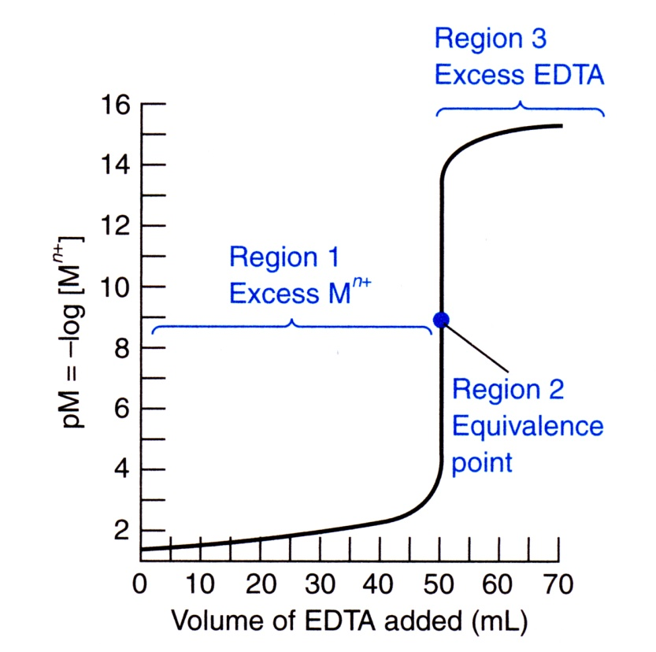
EDTA Titrations
EDTA Titration Curves
1.) Titration Curve
The titration of a metal ion with EDTA is similar to the titration of a strong acid (M⁺) with a weak base (EDTA)
The Titration Curve has three distinct regions:
Before the equivalence point (excess M^{n+})
At the equivalence point [EDTA]=[M^{n+}]
After the equivalence point (excess EDTA)

Slide 12
EDTA Titrations
EDTA Titration Curves
2.) Example
What is the value of [M^{n+}] and pM for 50.0 ml of a 0.05 M Mg²⁺ solution buffered at pH 10.0 and titrated with 0.05 M EDTA when (a) 5.0 mL, (b) 50.0 mL and (c) 51.0 mL EDTA is added?
K_{f} = 10^{8.79} = 6.2x10⁸
α_{Y4-} at pH 10.0 = 0.30
mL EDTA at equivalence point:
mmol of EDTA
mmol of Mg²⁺

Slide 13
EDTA Titrations
EDTA Titration Curves
2.) Example
(a) Before Equivalence Point ( 5.0 mL of EDTA)
Before the equivalence point, the [M^{n+}] is equal to the concentration of excess unreacted M^{n+}. Dissociation of MY^{n-4} is negligible.
moles of Mg²⁺
originally present
moles of EDTA added
Original volume
solution
Volume titrant
added
Dilution effect

Slide 14
EDTA Titrations
EDTA Titration Curves
2.) Example
(b) At Equivalence Point ( 50.0 mL of EDTA)
Virtually all of the metal ion is now in the form MgY²⁻
Original volume of
M^{n+} solution
Original [M^{n+}]
Moles Mg⁺ ≡ moles MgY²⁻
Original volume
solution
Volume titrant
added
Dilution effect

Slide 15
EDTA Titrations
EDTA Titration Curves
2.) Example
(b) At Equivalence Point ( 50.0 mL of EDTA)
The concentration of free Mg²⁺ is then calculated as follows:
Initial Concentration (M) | 0 | 0 | 0.025
Final Concentration (M) | x | x | 0.025 - x
Solve for x using the quadratic equation:

Slide 16
EDTA Titrations
EDTA Titration Curves
2.) Example
(c) After the Equivalence Point ( 51.0 mL of EDTA)
Virtually all of the metal ion is now in the form MgY²⁻ and there is excess, unreacted EDTA. A small amount of free M^{n+} exists in equilibrium with MgY⁴⁻ and EDTA.
Calculate excess [EDTA]:
Volume excess
titrant
Original [EDTA]
Excess moles EDTA
عدد مولات / حجم
Original volume
solution
Volume titrant
added
Dilution effect

Slide 17
EDTA Titrations
EDTA Titration Curves
2.) Example
(c) After the Equivalence Point ( 51.0 mL of EDTA)
Calculate [MgY²⁻]:
Original volume of
M^{n+} solution
Original [M^{n+}]
Moles Mg⁺ ≡ moles MgY²⁻
Only Difference
Original volume
solution
Volume titrant
added
Dilution effect

Slide 18
EDTA Titrations
EDTA Titration Curves
2.) Example
(c) After the Equivalence Point ( 51.0 mL of EDTA)
[Mg²⁺⁻] is given by the equilibrium expression using [EDTA] and [MgY²⁻]:

Slide 19
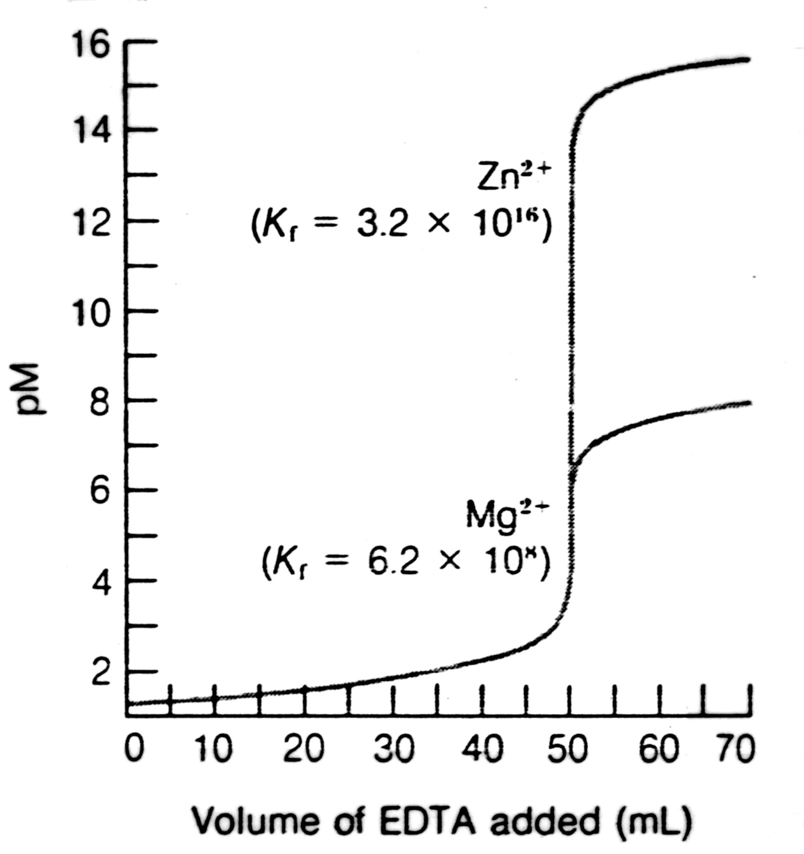
EDTA Titrations
EDTA Titration Curves
2.) Example
Final titration curve for 50.0 ml of 0.05 M Mg²⁺ with 0.05 M EDTA at pH 10.00.
Also shown is the titration of 50.0 mL of 0.05 M Zn²⁺
Note: the equivalence point is sharper for Zn²⁺ vs. Mg²⁺. This is due to Zn²⁺ having a larger formation constant.
The completeness of these reactions is dependent on α_{Y4-} and correspondingly pH.
pH is an important factor in setting the completeness and selectivity of an EDTA titration

Slide 20
EDTA Titrations
Auxiliary Complexing Agents
1.) Metal Hydroxide
In general, as pH increases a titration of a metal ion with EDTA will have a higher K_{f}.
Larger change at the equivalence point.
Exception: If M^{n+} reacts with OH⁻ to form an insoluble metal hydroxide
Auxiliary Complexing Agents: a ligand can be added that complexes with M^{n+} strong enough to prevent hydroxide formation.
Ammonia, tartrate, citrate or triethanolamine
Binds metal weaker than EDTA
Fraction of free metal ion (α_{M}) depends on the equilibrium constants (β) or cumulative formation constants:
Use a new conditional formation constant that incorporates the fraction of free metal:

Slide 21
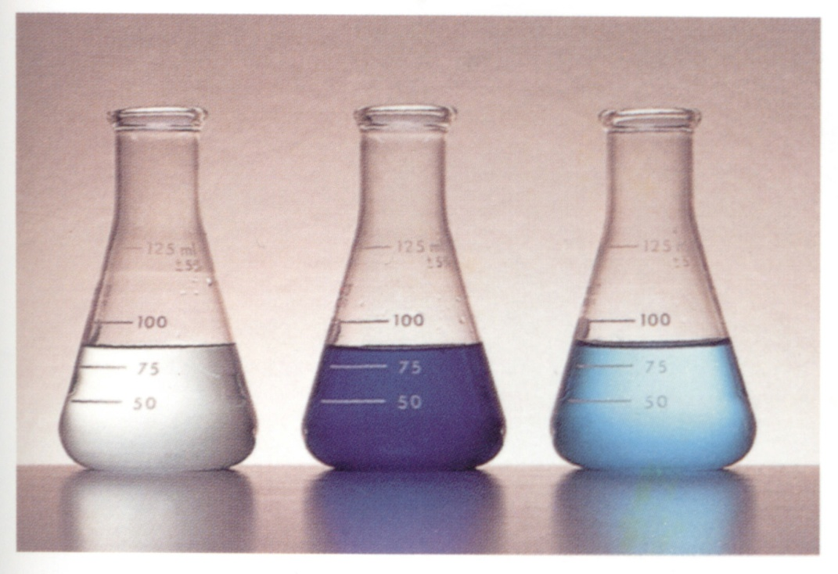
EDTA Titrations
Auxiliary Complexing Agents
2.) Illustration:
Titration of Cu⁺² (CuSO₄) with EDTA
Addition of Ammonia Buffer results in a dark blue solution
Cu(II)-ammonia complex is formed
Addition of EDTA displaces ammonia with corresponding color change
CuSO₄
Cu-ammonia
Cu-EDTA

Slide 22
EDTA Titrations
Metal Ion Indicators
1.) Determination of EDTA Titration End Point
Four Methods:
Metal ion indicator
Mercury electrode
pH electrode
Ion-selective electrode
Metal Ion Indicator: a compound that changes color when it binds to a metal ion
Similar to pH indicator, which changes color with pH or as the compound binds H⁺
For an EDTA titration, the indicator must bind the metal ion less strongly than EDTA
Similar in concept to Auxiliary Complexing Agents
Needs to release metal ion to EDTA
Potential Measurements
End Point indicated by a color change from red to blue
(red)
(colorless)
(colorless)
(blue)

Slide 23
EDTA Titrations
Metal Ion Indicators
2.) Illustration
Titration of Mg²⁺ by EDTA
Eriochrome Black T Indicator
Addition of EDTA
Before Near After
Equivalence point

Slide 24
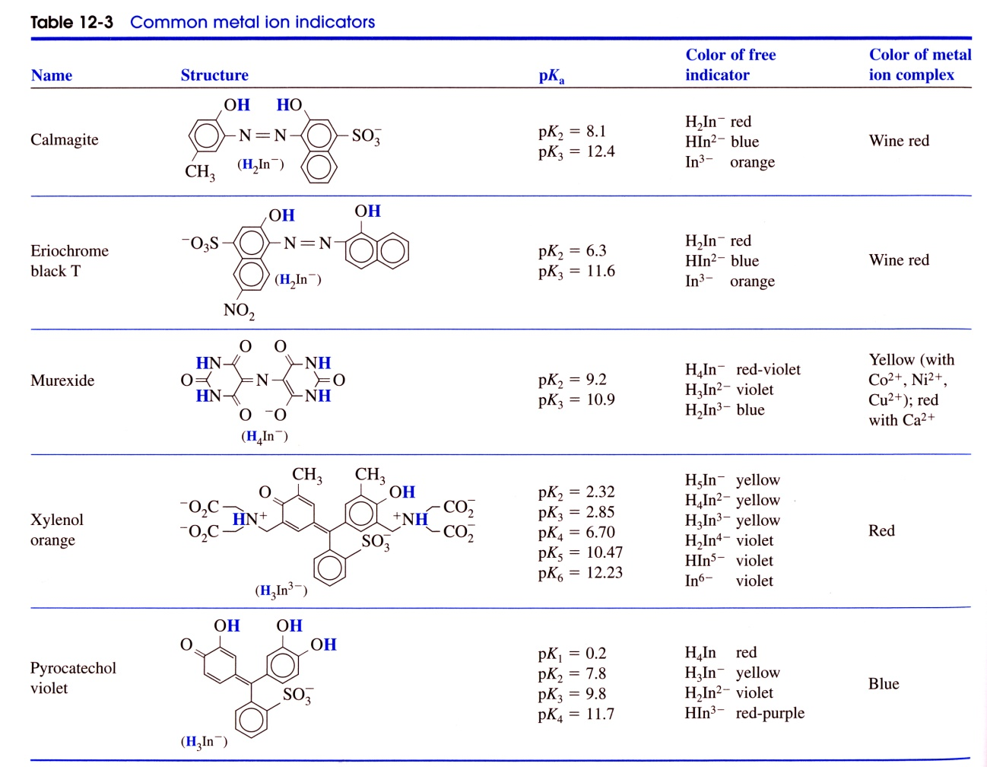
EDTA Titrations
Metal Ion Indicators
3.) Common Metal Ion Indicators
Most are pH indicators and can only be used over a given pH range

